Slide 1

Introduction to data analysis
Oleksii Yehorchenkov
Taras Shevchenko National University of Kyiv
License
These materials are available under the Creative Commons Attribution NonCommercial ShareAlike (CC-NC-SA) license
https://creativecommons.org/licenses/by-nc-sa/3.0/

Slide 2

Types of Data Science Questions

Slide 3
The data analysis question
Define the data analytic question first
Data can be used to answer many questions, but not all of them.
The data may not contain the answer. The combination of some data and an aching desire for an answer does not ensure that a reasonable answer can be extracted from a given body of data.
John Tukey
Before performing a data analysis the key is to define the type of question being asked. Some questions are easier to answer with data and some are harder. This is a broad categorization of the types of data analysis questions, ranked by how easy it is to answer the question with data.

Slide 4
The data analysis question
type flow chart
In approximate order of difficulty
Descriptive – описовий
Exploratory – дослідний
Inferential – дедуктивний
Predictive – прогностичний
Causal – причинно-наслідковий
Mechanistic - механістичний

Slide 5
Descriptive (описовий)
A descriptive data analysis seeks to summarize the measurements in a single data set without further interpretation.
Goal: Describe a set of data
The first kind of data analysis performed
Commonly applied to census data
The description and interpretation are different steps
Descriptions can usually not be generalized (узагальнені) without additional statistical modelling

Slide 6
Descriptive (описовий)
An example is the United States Census. The Census collects data on the residence type, location, age, sex, and race of all people in the United States at a fixed time. The Census is descriptive because the goal is to summarize the measurements in this fixed data set into population counts and describe how many people live in different parts of the United States. The interpretation and use of these counts is left to Congress and the public, but is not part of the data analysis.

Slide 7
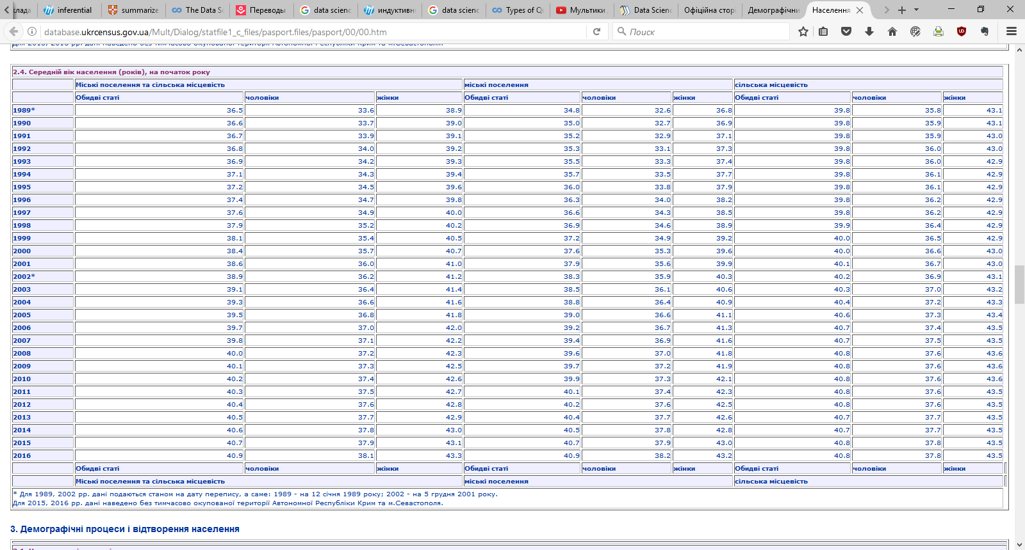
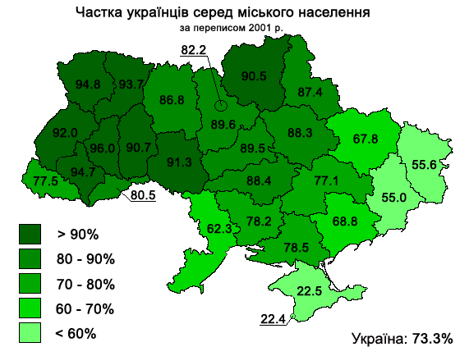
Descriptive (описовий)
http://database.ukrcensus.gov.ua/Mult/Dialog/statfile1_c_files/pasport.files/pasport/00/00.htm
Auther: Tovel – Own work, CC BY-SA 3.0, https://commons.wikimedia.org/w/index.php?curid=17803834

Slide 8
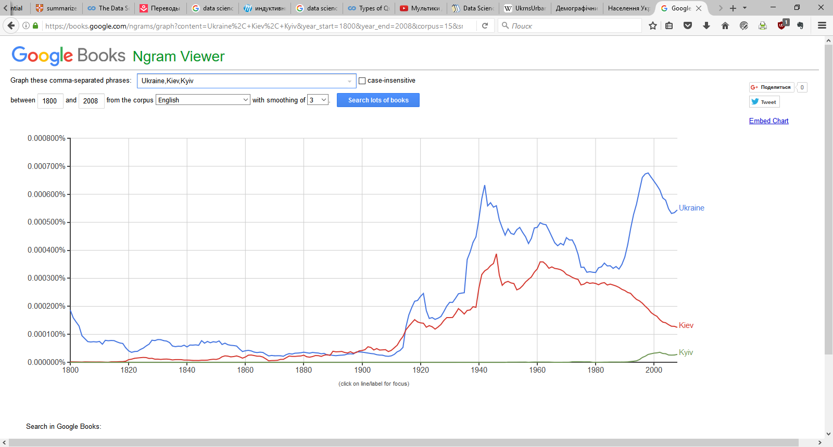
Descriptive (описовий)
https://books.google.com/ngrams

Slide 9
Exploratory (дослідний)
An exploratory data analysis builds on a descriptive analysis by searching for discoveries, trends, correlations, or relationships between the measurements of multiple variables to generate ideas or hypotheses.
Goal: Find relationships you didn’t know about
Exploratory models are good for discovering new connections
They are also useful for defining future studies
Exploratory analyses are usually not the final say
Exploratory analyses alone should not be used for generalizing/predicting
Correlations does not imply causation

Slide 10

Exploratory (дослідний)
An example is the discovery of a four-planet solar system by amateur astronomers using public astronomical data from the Kepler telescope. The data was made available through the planethunters.org website, that asked amateur astronomers to look for a characteristic pattern of light indicating potential planets. An exploratory analysis like this one seeks to make discoveries, but rarely can confirm those discoveries. In the case of the amateur astronomers, follow-up studies and additional data were needed to confirm the existence of the four-planet system.
https://www.zooniverse.org/projects/nora-dot-eisner/planet-hunters-tess

Slide 11
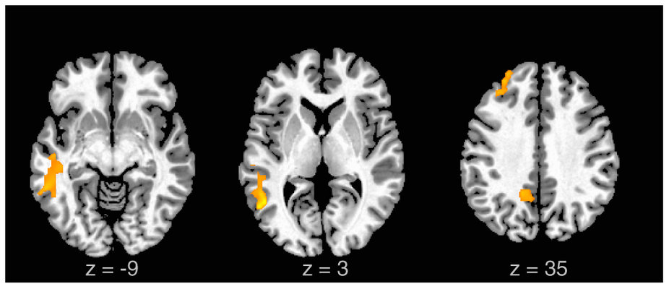
Exploratory (дослідний)
http://www.nature.com/srep/2012/121115/srep00834/full/srep00834.html

Slide 12
Inferential (дедуктивний, виведений)
An inferential data analysis goes beyond an exploratory analysis by quantifying whether an observed pattern will likely hold beyond the data set in hand. Inferential data analyses are the most common statistical analysis in the formal scientific literature.
Goal: Use a relatively small sample of data to say something about a bigger population
Inference is commonly the goal of statistical models
Inference involves estimating both the quantity you care about and your uncertainty (невизначеність) about your estimate
Inference depends heavily on both the population (кількість даних) and the sampling scheme (схема вибірки)

Slide 13
Inferential (дедуктивний, виведений)
An example is a study of whether air pollution correlates with life expectancy (тривалість життя) at the state level in the United States. The goal is to identify the strength of the relationship in both the specific data set and to determine whether that relationship will hold in future data. In non-randomized experiments, it is usually only possible to observe whether a relationship between two measurements exists. It is often impossible to determine how or why the relationship exists – it could be due to unmeasured data, relationships, or incomplete modeling.

Slide 14
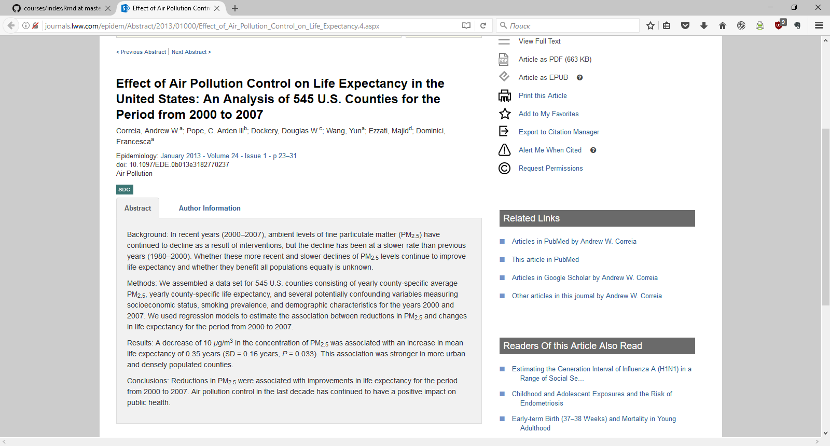
Inferential (дедуктивний, виведений)
http://journals.lww.com/epidem/Abstract/2013/01000/Effect_of_Air_Pollution_Control_on_Life_Expectancy.4.aspx

Slide 15
Predictive (прогностичний)
While an inferential data analysis quantifies the relationships among measurements at population-scale, a predictive data analysis uses a subset of measurements (the features) to predict another measurement (the outcome) on a single person or unit.
Goal: To use the data on some objects to predict values for another object
If $X$ predicts $Y$ it does not mean that $X$ causes $Y$
Accurate prediction depends heavily on measuring the right variables
Although there are better and worse prediction models, more data and a simple model works really well
Prediction is very hard, especially about the future references

Slide 16
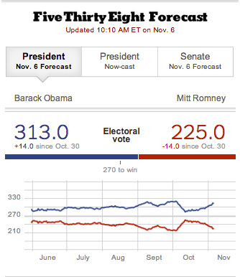
Predictive (прогностичний)
An example is when organizations like FiveThirtyEight.com use polling data (дані опитування) to predict how people will vote on election day. In some cases, the set of measurements used to predict the outcome will be intuitive. There is an obvious reason why polling data may be useful for predicting voting behavior. But predictive data analyses only show that you can predict one measurement from another, they don’t necessarily explain why that choice of prediction works.

Slide 17
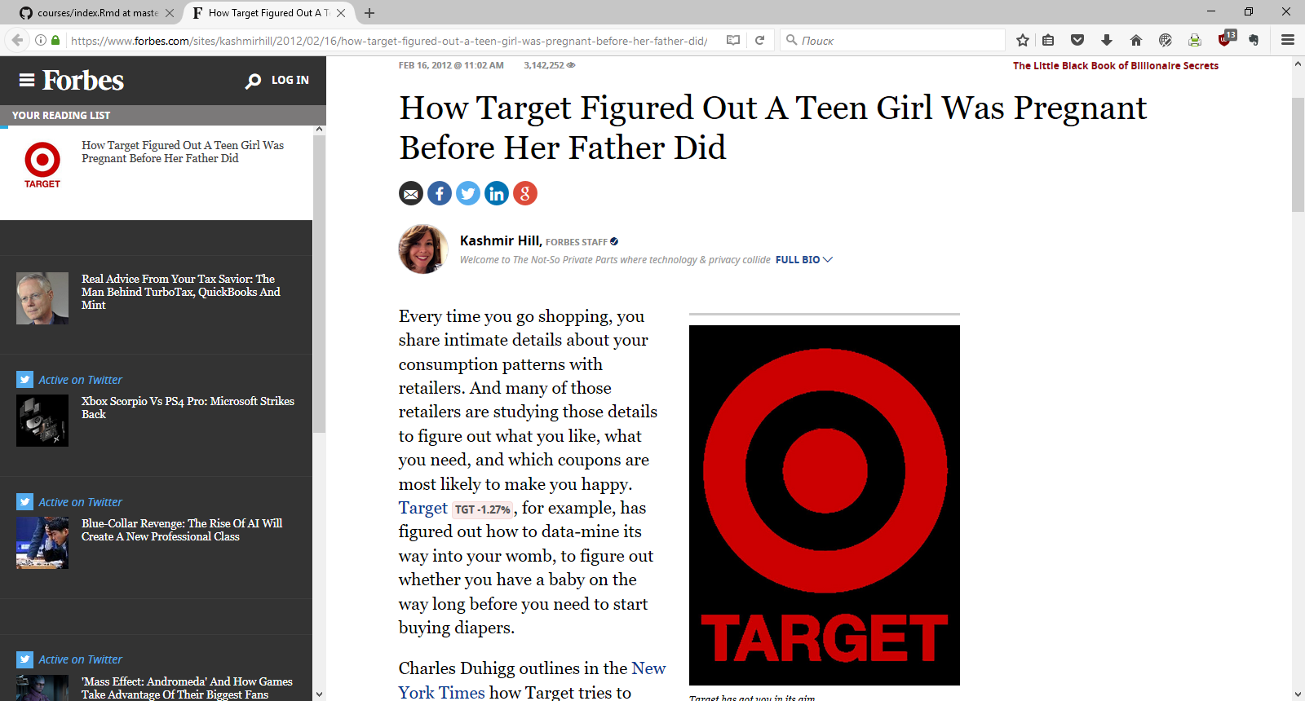
Predictive (прогностичний)
https://www.forbes.com/sites/kashmirhill/2012/02/16/how-target-figured-out-a-teen-girl-was-pregnant-before-her-father-did/#2e4133326668

Slide 18
Causal (причинно-наслідковий)
A causal data analysis seeks to find out what happens to one measurement if you make another measurement change.
Goal: To find out what happens to one variable when you make another variable change.
Usually randomized studies are required to identify causation
There are approaches to inferring causation in non-randomized studies, but they are complicated and sensitive to assumptions
Causal relationships are usually identified as average effects, but may not apply to every individual
Causal models are usually the "gold standard" for data analysis

Slide 19
Causal (причинно-наслідковий)
Causal analysis is plausible reasoning applied to diagnosing observed effect(s), for example, diagnosing cause of biological impairment (погіршення) in a stream. Sir Bradford Hill basically defined the application of causal analysis when he enumerated the elements of causality for associating cigarette smoking with lung cancer.

Slide 20
Mechanistic (механістичний)
Causal data analyses seek to identify average effects between often noisy variables. For example, decades of data show a clear causal relationship between smoking and cancer. If you smoke, it is a sure thing that your risk of cancer will increase. But it is not a sure thing that you will get cancer. The causal effect is real, but it is an effect on your average risk. A mechanistic data analysis seeks to demonstrate that changing one measurement always and exclusively leads to a specific, deterministic behavior in another. The goal is to not only understand that there is an effect, but how that effect operates.
Goal: Understand the exact changes in variables that lead to changes in other variables for individual objects.
Incredibly hard to infer, except in simple situations
Usually modeled by a deterministic set of equations (physical/engineering science)
Generally the random component of the data is measurement error
If the equations are known but the parameters are not, they may be inferred (виведені) with data analysis

Slide 21
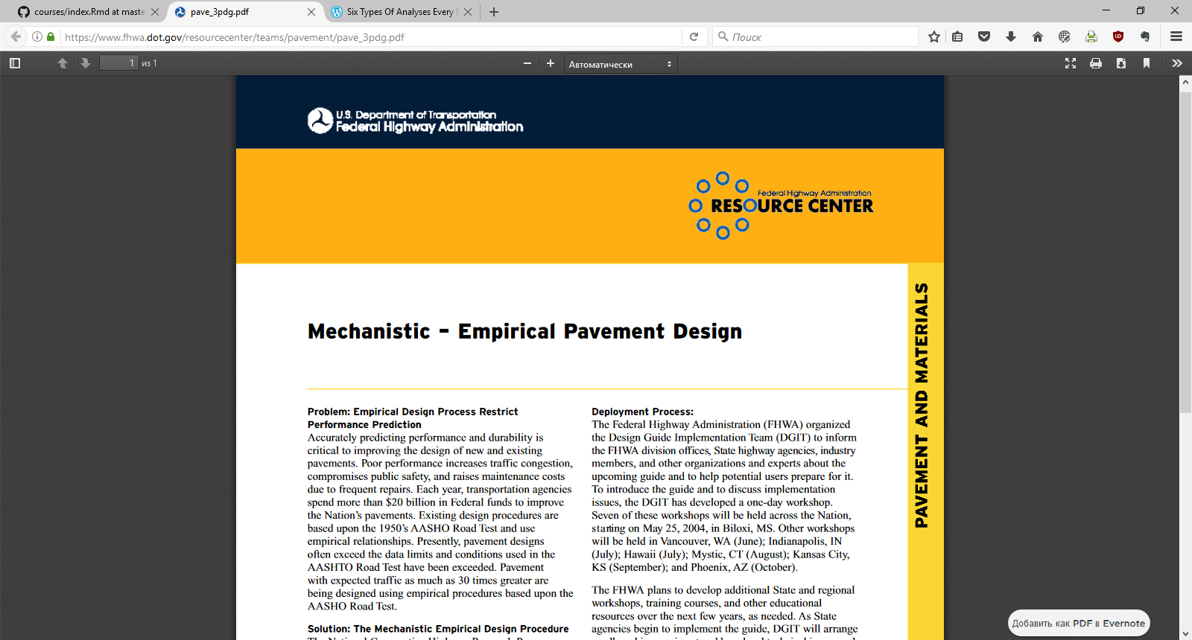
Mechanistic (механістичний)
https://www.fhwa.dot.gov/resourcecenter/teams/pavement/pave_3pdg.pdf

Slide 22
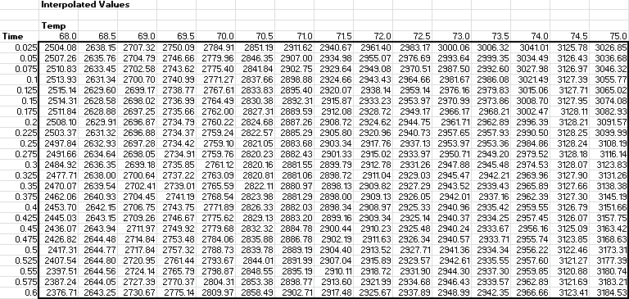
What is data?

Slide 23
Definition of Data
“Data is a set of values of qualitative or quantitative variables.”
“Дані – це набір значень якісних або кількісних змінних.”
https://en.wikipedia.org/wiki/Data

Slide 24
Definition of Data
“Data is a set of values of qualitative or quantitative variables.”
“Дані – це набір значень якісних або кількісних змінних.”
https://en.wikipedia.org/wiki/Data
Set: Sometimes called the population; the set of objects you are interested in

Slide 25
Definition of Data
“Data is a set of values of qualitative or quantitative variables.”
“Дані – це набір значень якісних або кількісних змінних.”
https://en.wikipedia.org/wiki/Data
Variables: A measurement or characteristic of an item.

Slide 26
Definition of Data
“Data is a set of values of qualitative or quantitative variables.”
“Дані – це набір значень якісних або кількісних змінних.”
https://en.wikipedia.org/wiki/Data
Qualitative: Country of origin, sex, treatment (лікування)
Quantitative: Height, weight, blood pressure

Slide 27
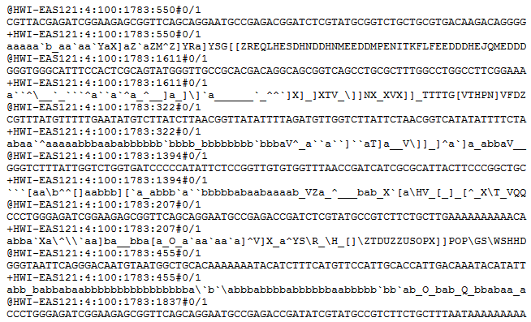
What do data look like?
http://brianknaus.com/software/srtoolbox/s_4_1_sequence80.txt

Slide 28
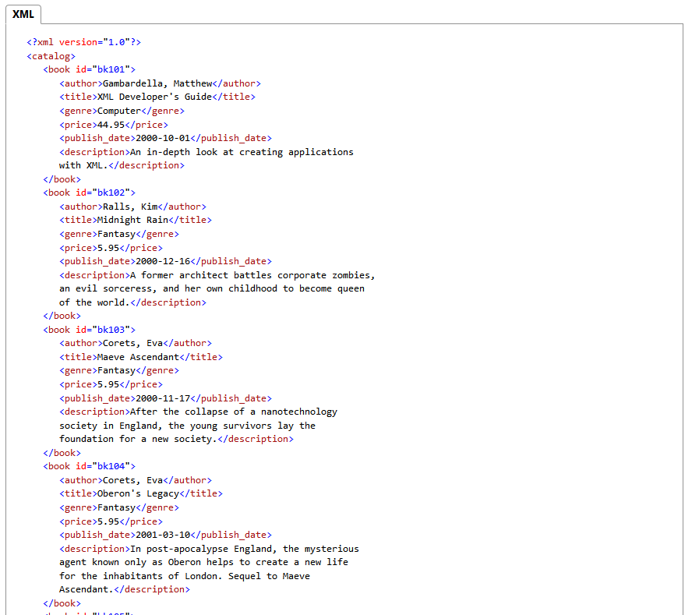
What do data look like?
https://msdn.microsoft.com/en-us/library/ms762271(v=vs.85).aspx

Slide 29
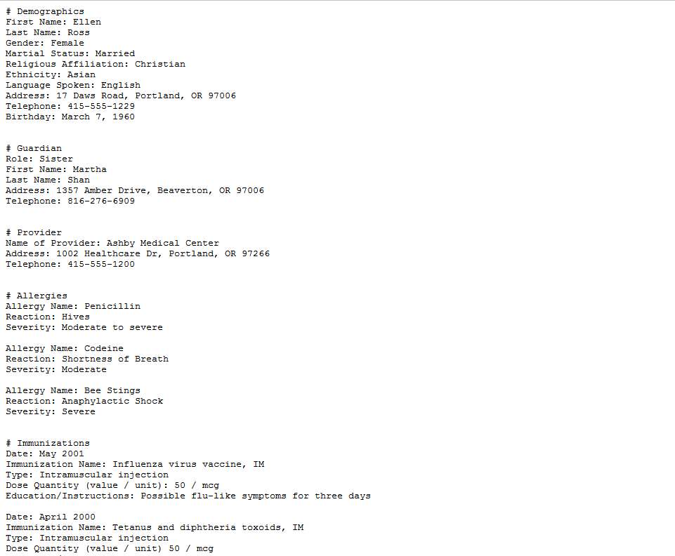
What do data look like?
http://healthdesignchallenge.com/files/sample-challenge-record.txt

Slide 30
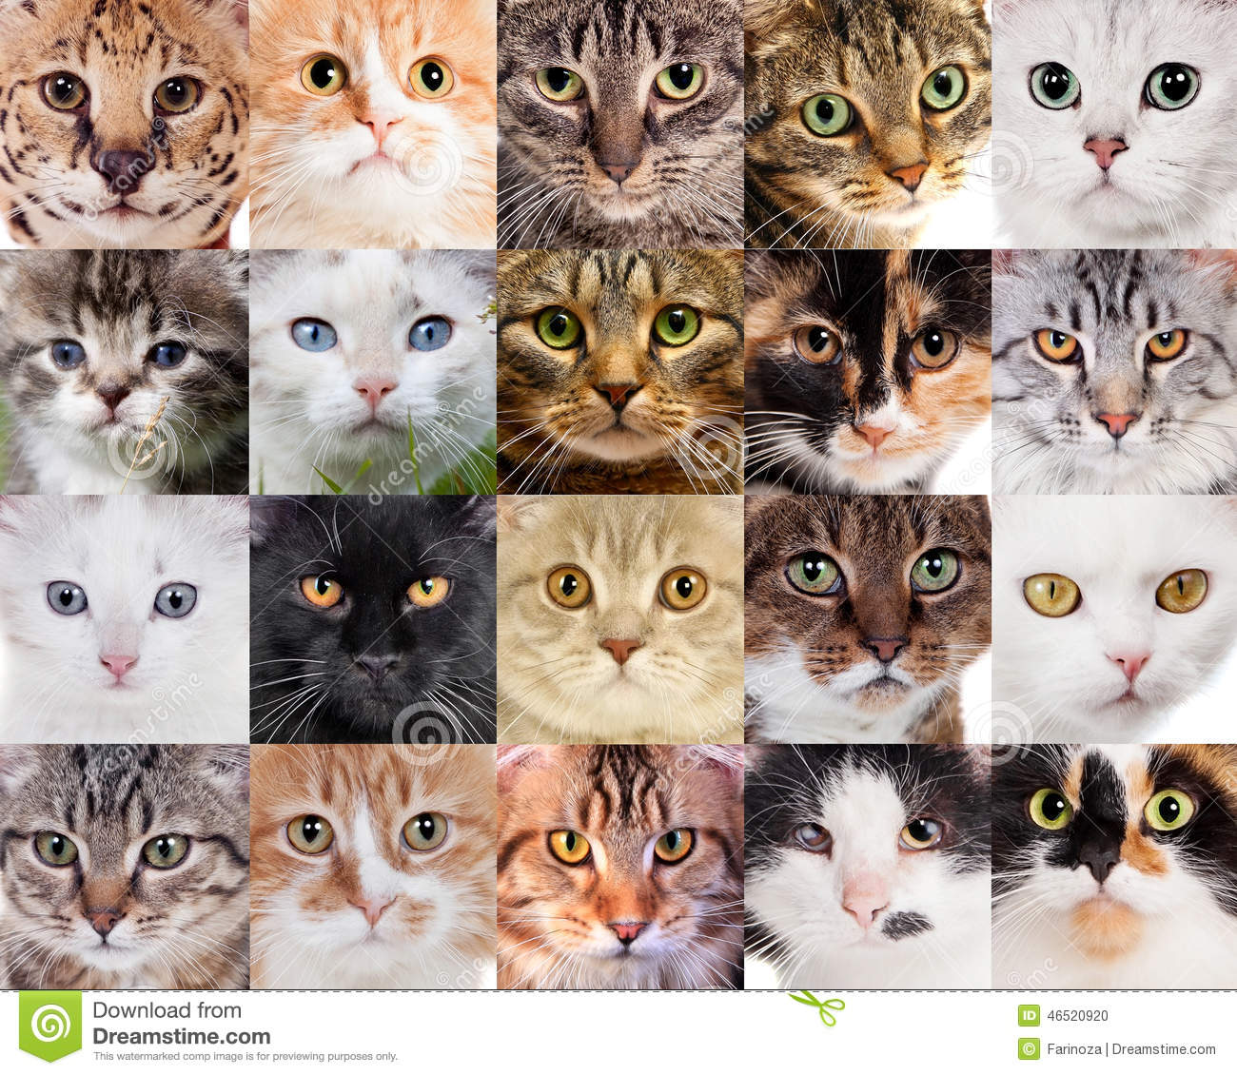
What do data look like?
https://www.dreamstime.com/stock-photo-collage-different-cute-cats-many-faces-image46520920

Slide 31
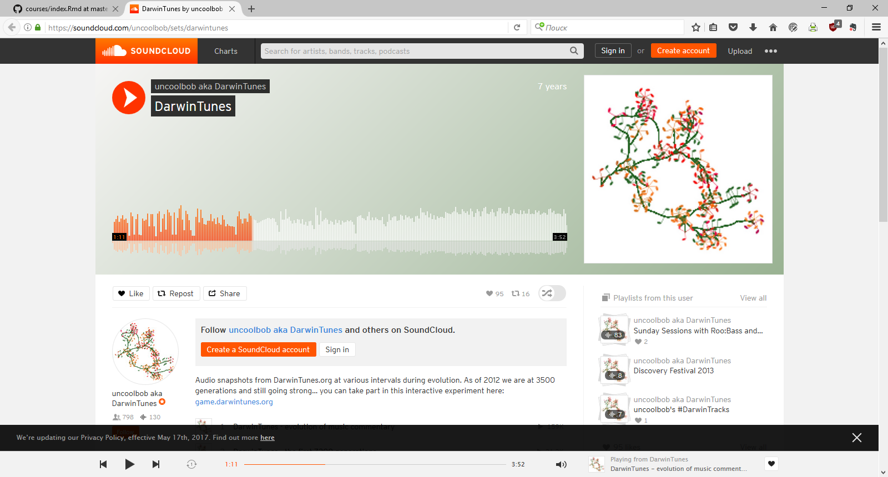
What do data look like?
https://soundcloud.com/uncoolbob/sets/darwintunes

Slide 32
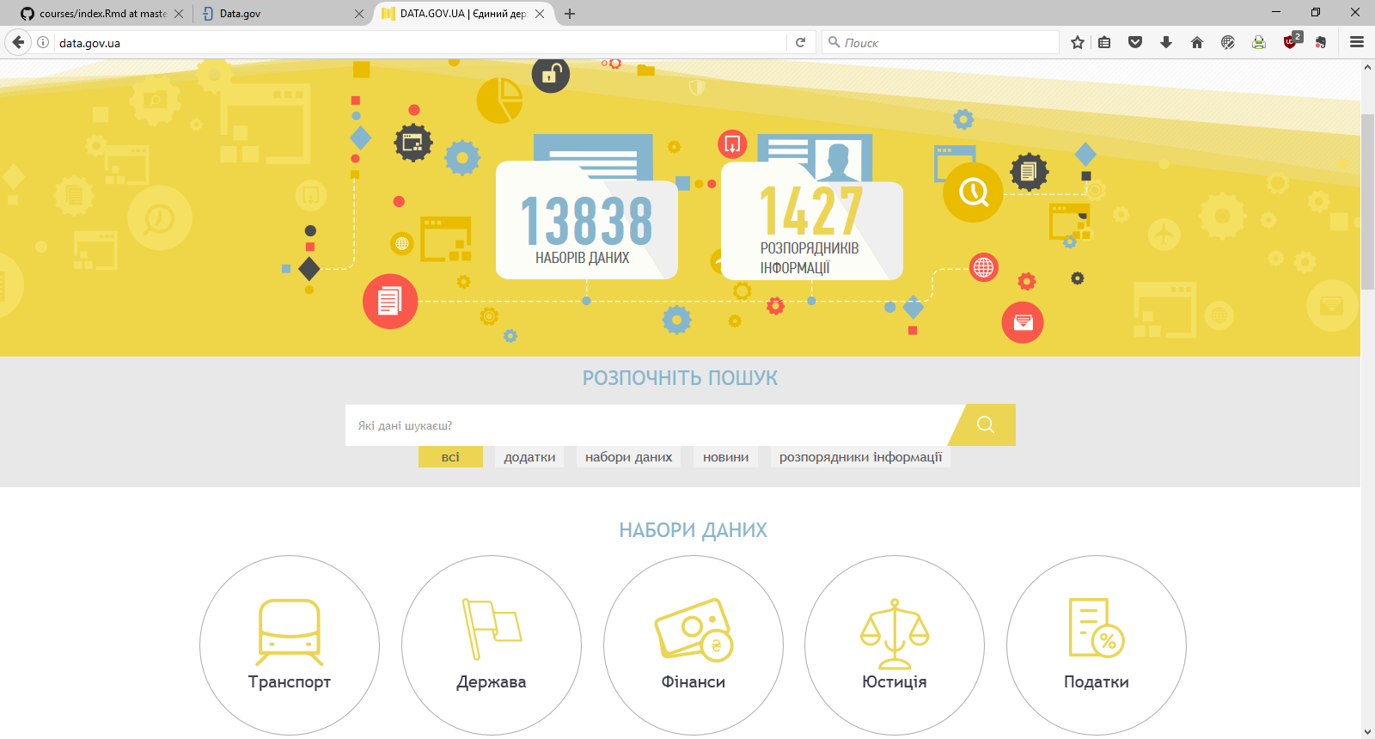
What do data look like?
http://data.gov.ua/

Slide 33
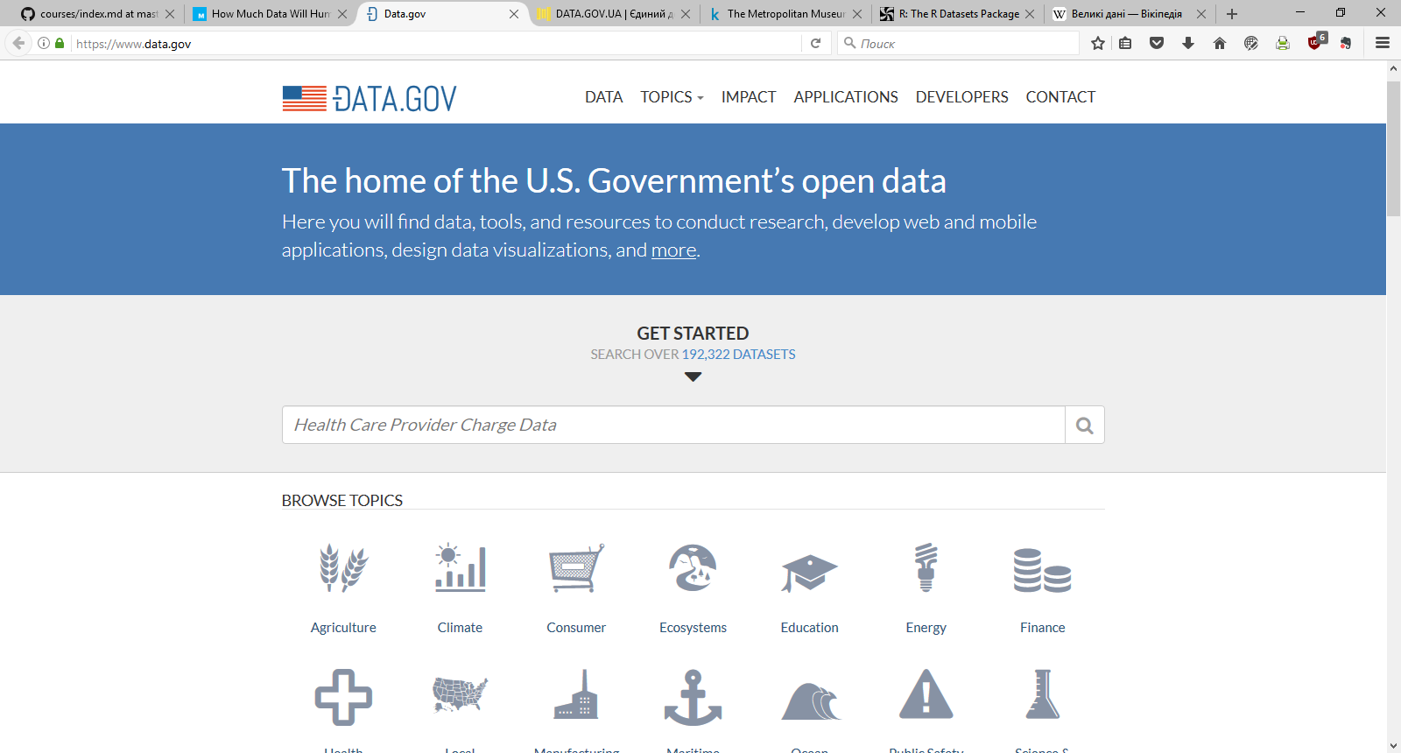
What do data look like?
http://data.gov/

Slide 34
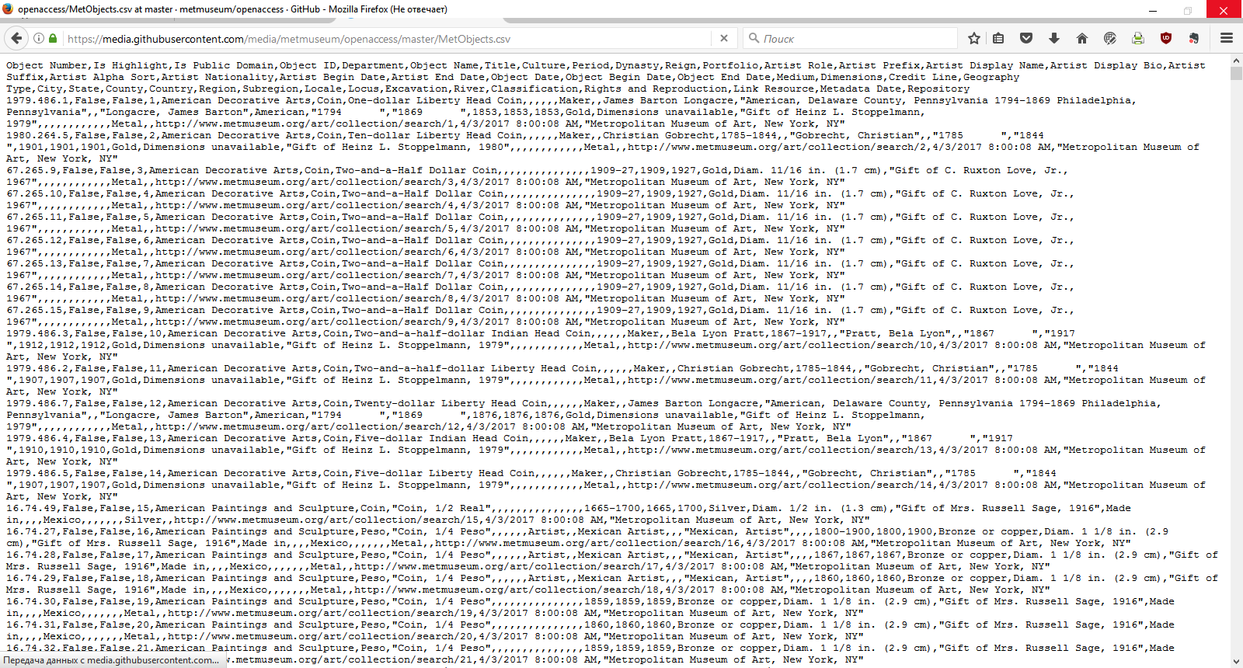
What do data look like? Rarely
https://github.com/metmuseum/openaccess, https://www.kaggle.com/metmuseum/the-metropolitan-museum-of-art-open-access

Slide 35
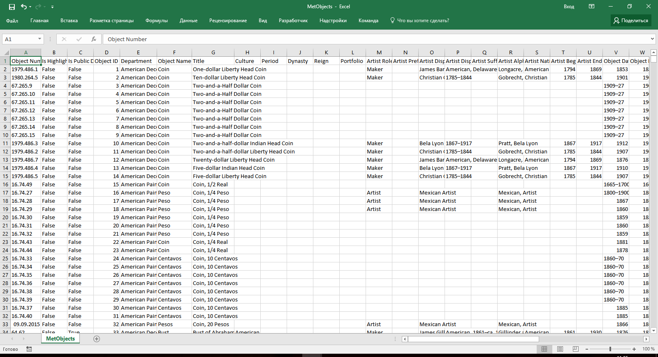
What do data look like? Rarely
https://github.com/metmuseum/openaccess, https://www.kaggle.com/metmuseum/the-metropolitan-museum-of-art-open-access

Slide 36
The data is the second most important thing
The most important thing in data science is the question
The second most important is the data
Often the data will limit or enable the questions
But having data can't save you if you don't have a question

Slide 37
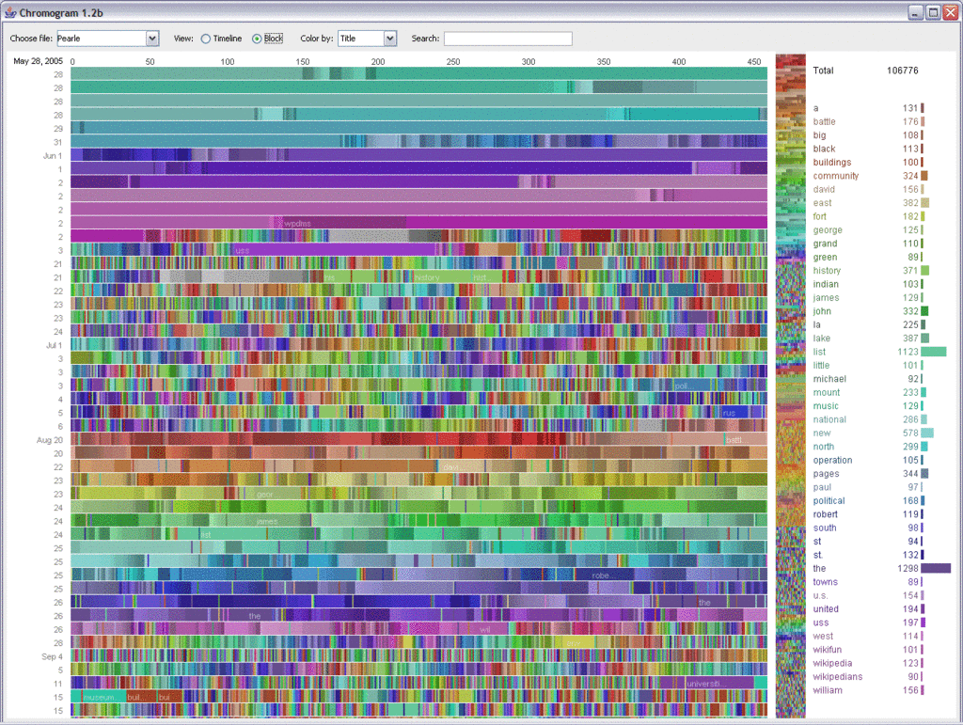
What about Big Data?
Auther: Fernanda B. Viégas - User activity on Wikipedia, CC BY 2.0, https://commons.wikimedia.org/w/index.php?curid=10090013

Slide 38
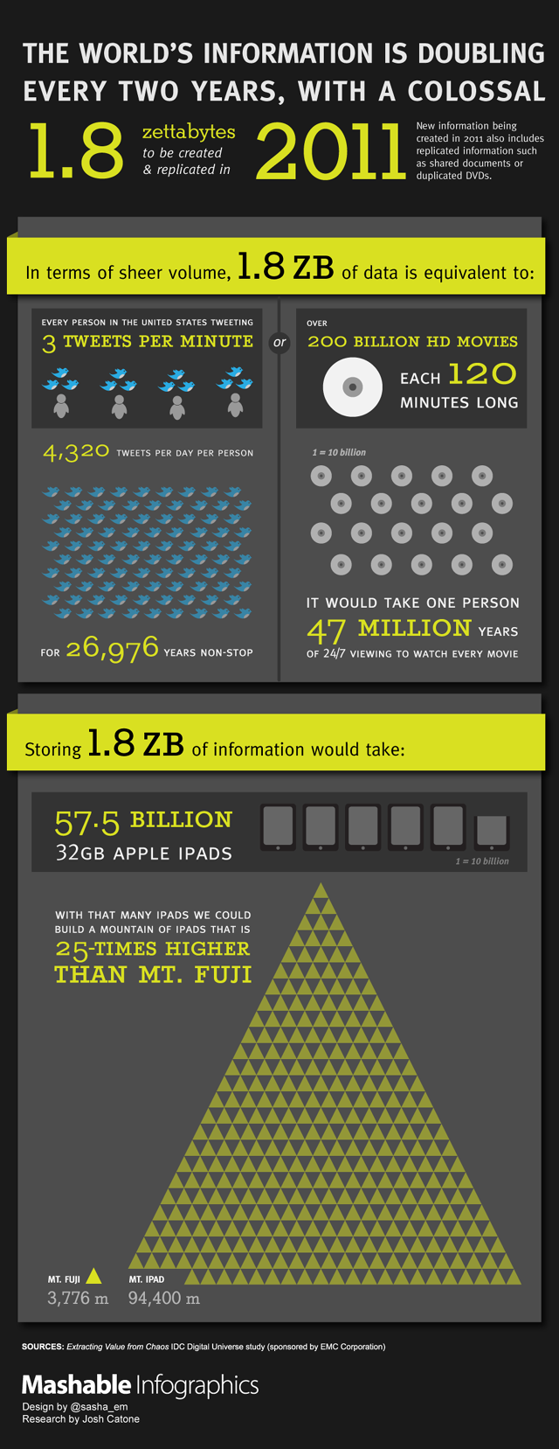
How much is there?
http://mashable.com/2011/06/28/data-infographic/

Slide 39
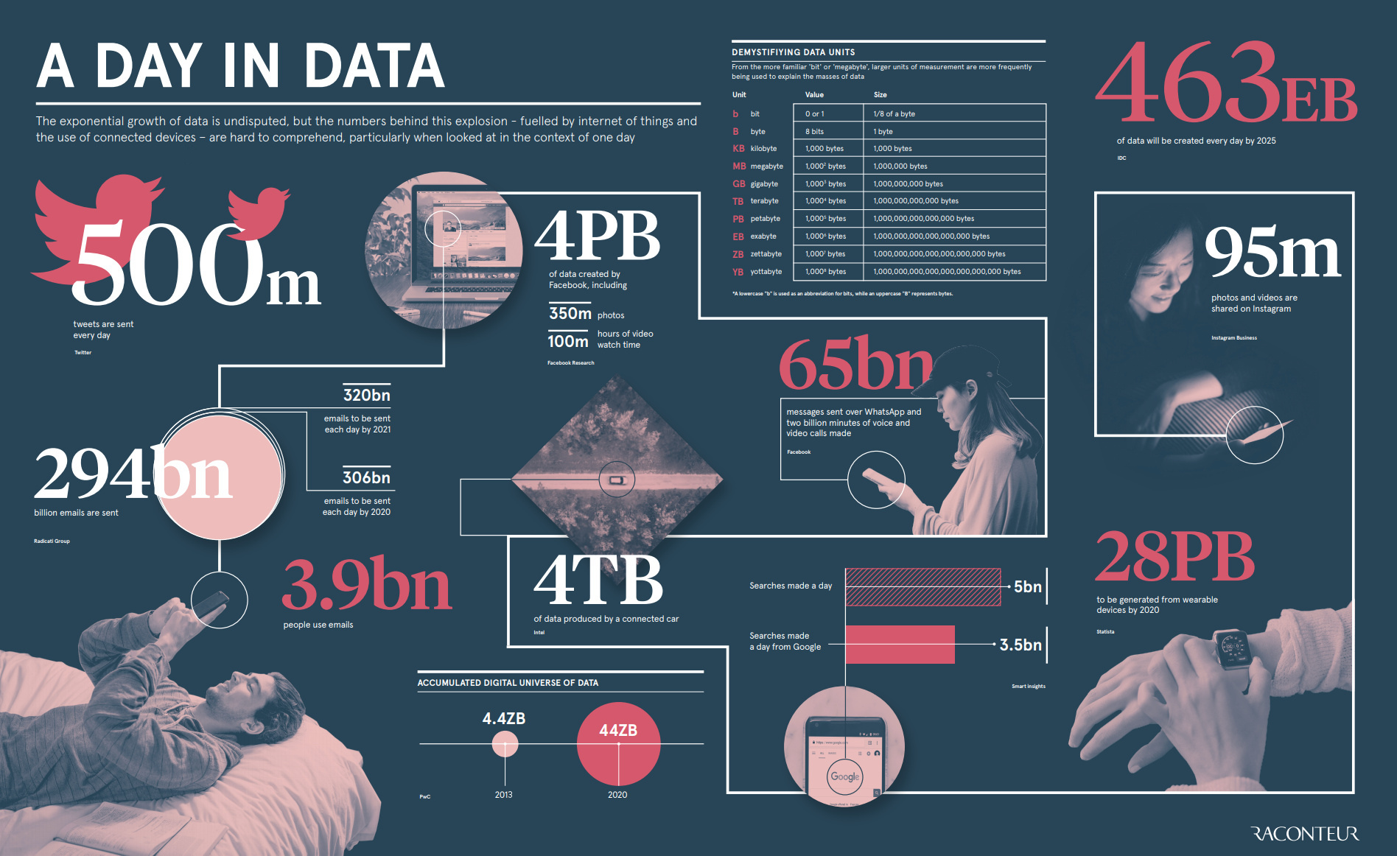
How much is there?
https://www.visualcapitalist.com/wp-content/uploads/2019/04/data-generated-each-day-wide.html

Slide 40

So what about big data?

Slide 41
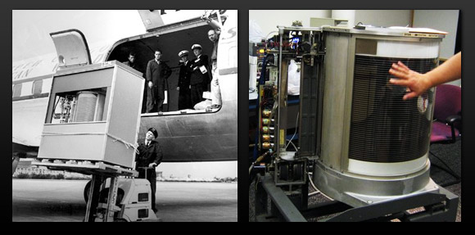
Depends on your perspective

Slide 42
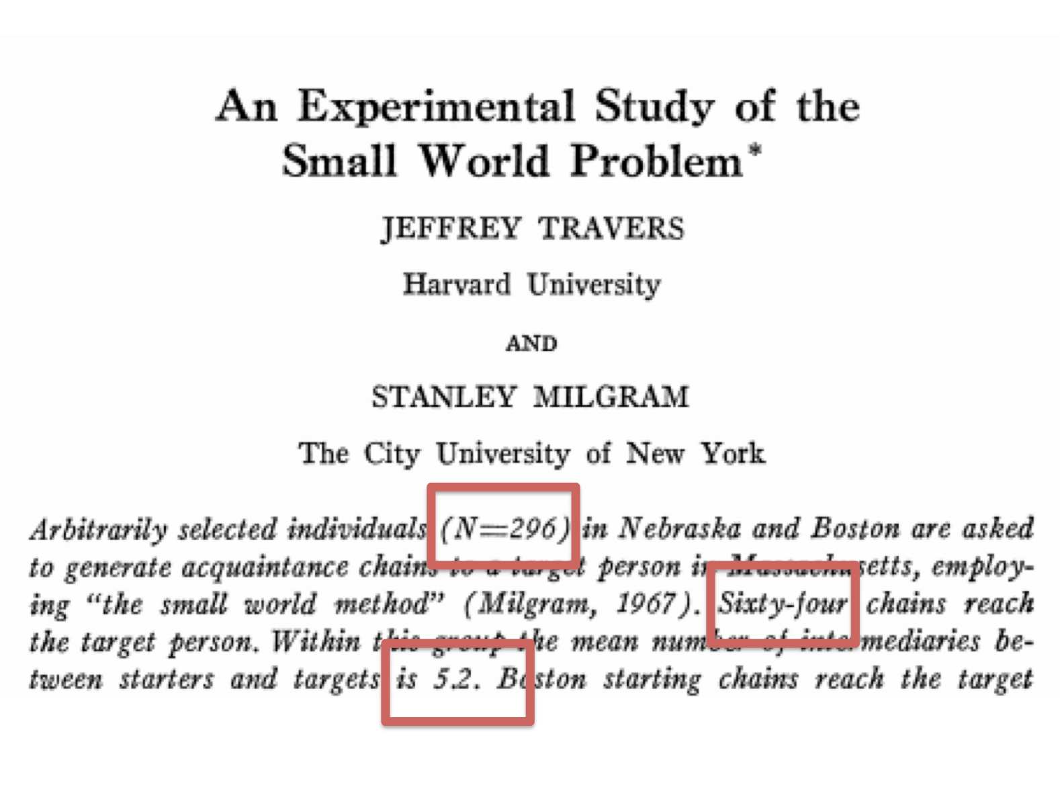
Why big data now?
http://www.jstor.org/discover/10.2307/2786545?uid=3739704&uid=2&uid=4&uid=3739256&sid=21101674727517

Slide 43
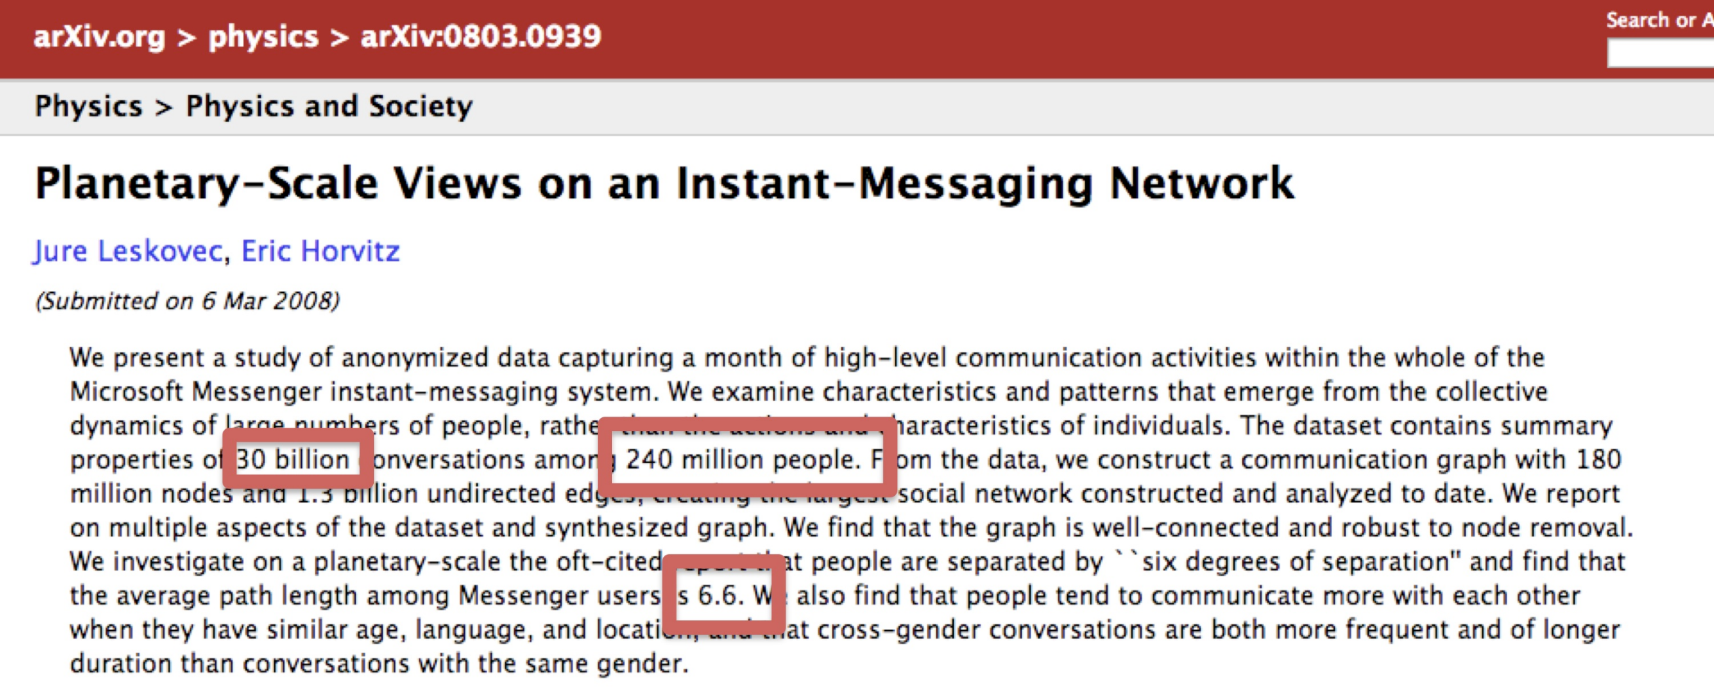
Why big data now?
http://arxiv.org/abs/0803.0939

Slide 44
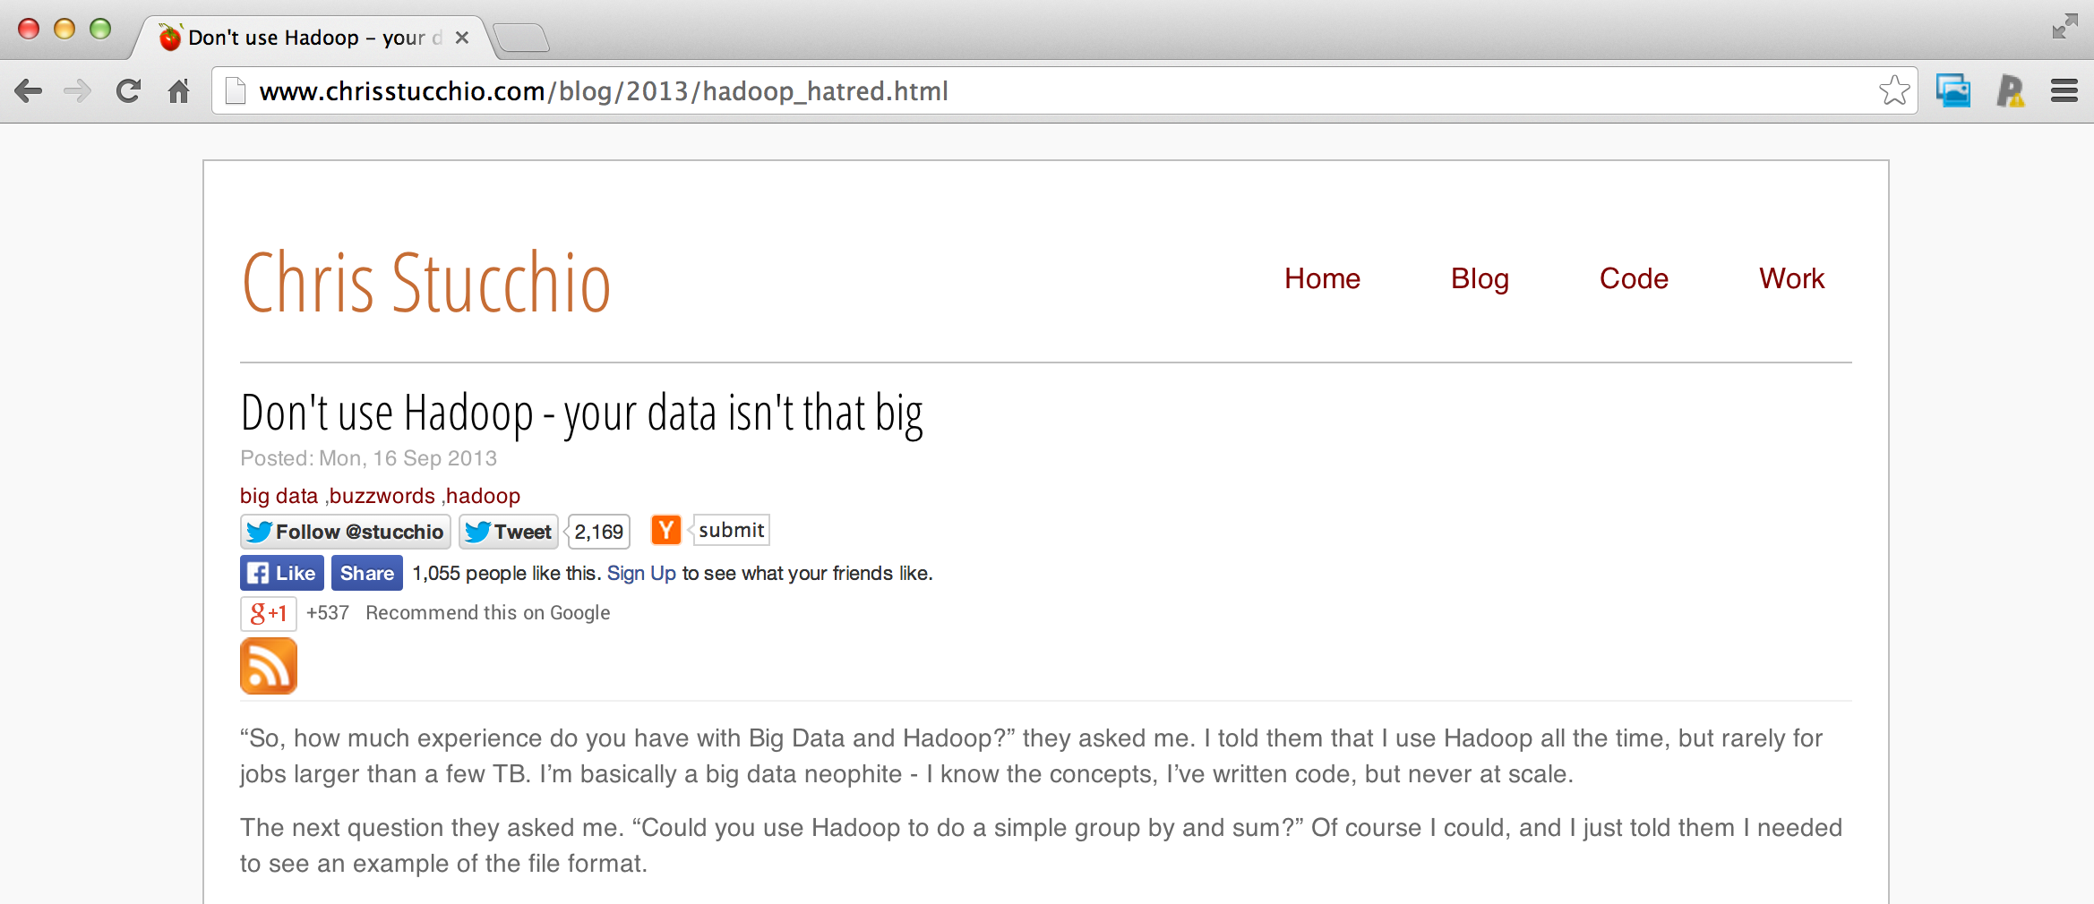
Big or small - you need the right data
http://www.chrisstucchio.com/blog/2013/hadoop_hatred.html

Slide 45
Big or small - you need the right data
“The data may not contain the answer. The combination of some data and an aching desire for an answer does not ensure that a reasonable answer can be extracted from a given body of data...”
John Tukey

Slide 46
Big or small - you need the right data
“...no matter how big the data are.”
Jeff Leek

Slide 47
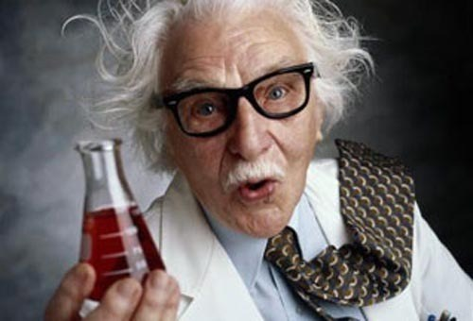
Experimental Design

Slide 48
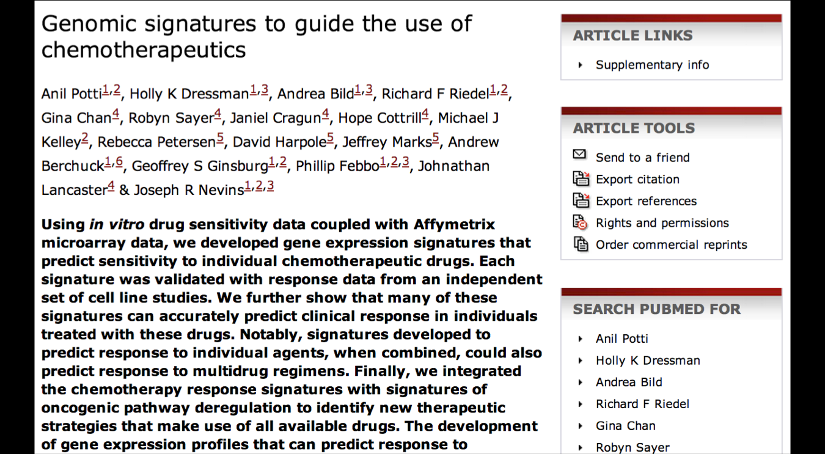
Why you should care - an exciting result!
http://www.nature.com/nm/journal/v12/n11/full/nm1491.html

Slide 49
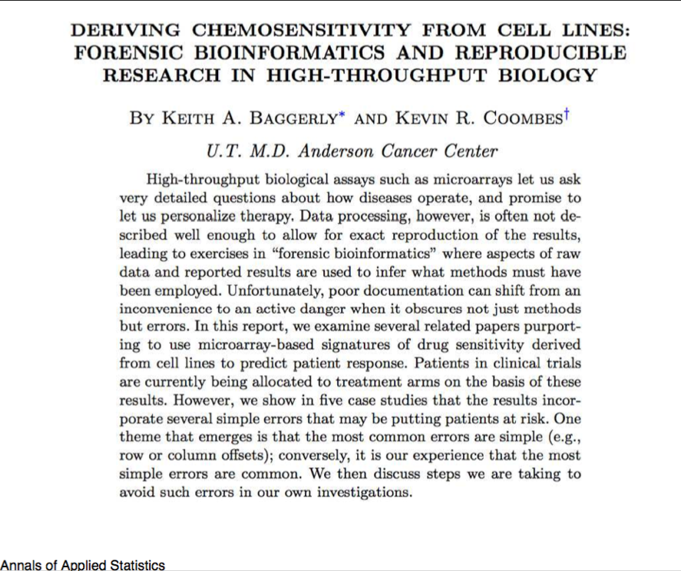
Why you should care - uh oh!
http://arxiv.org/pdf/1010.1092.pdf

Slide 50
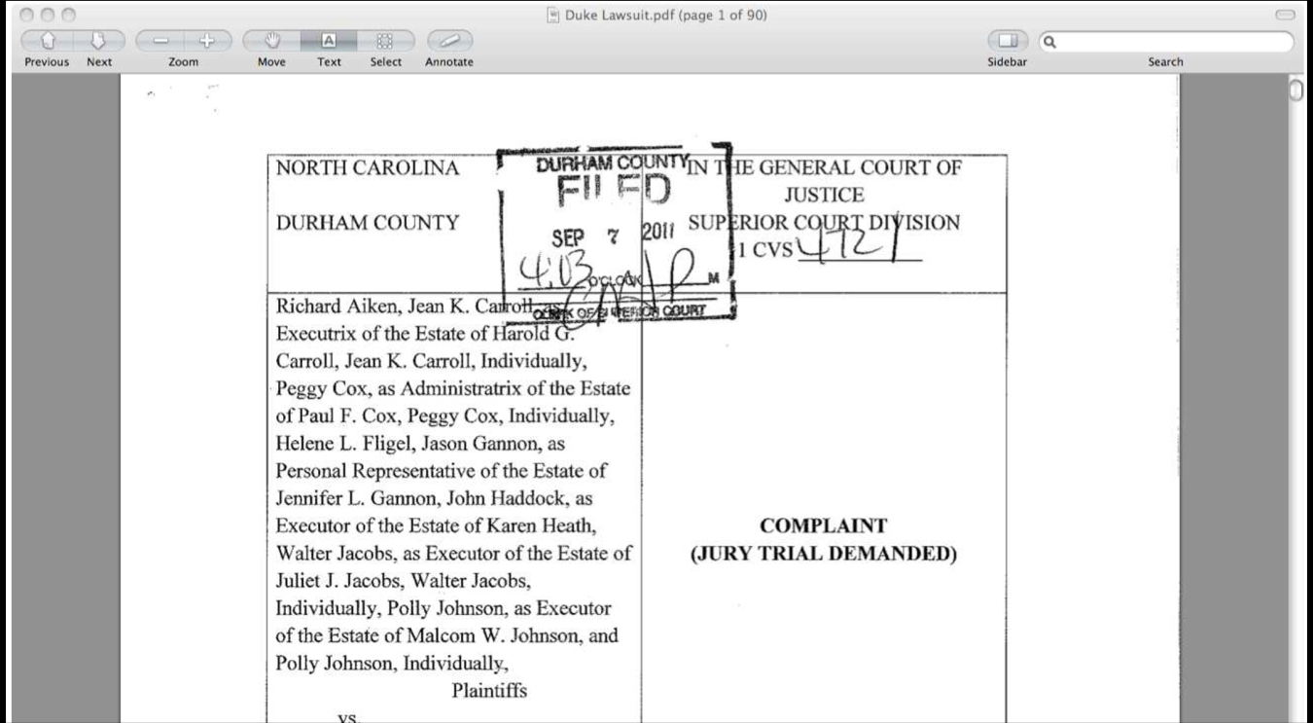
Why you should care - serious trouble

Slide 51
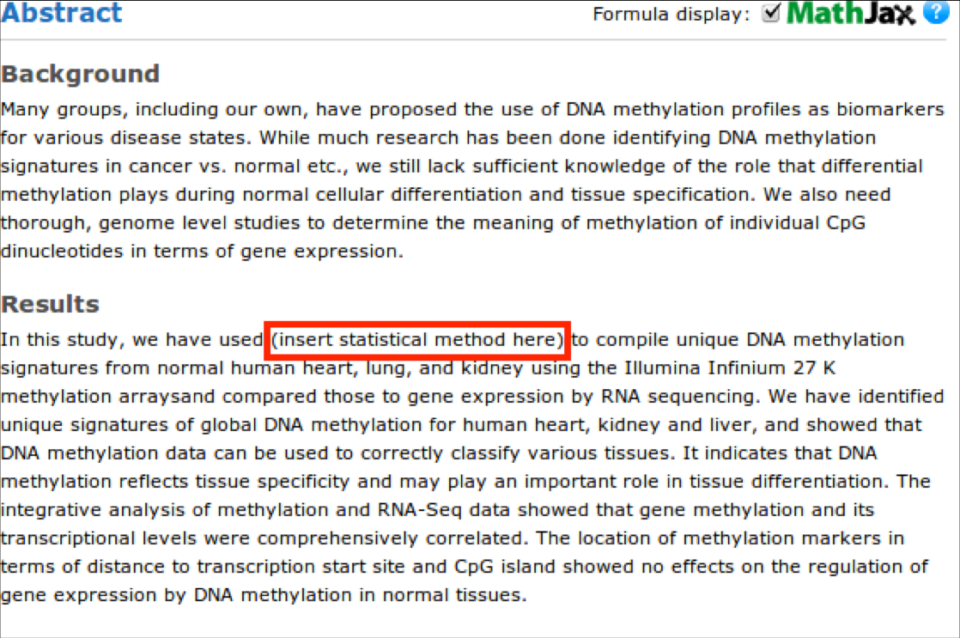
Know and care about the analysis plan!
http://nsaunders.wordpress.com/2012/07/23/we-really-dont-care-what-statistical-method-you-used/

Slide 52
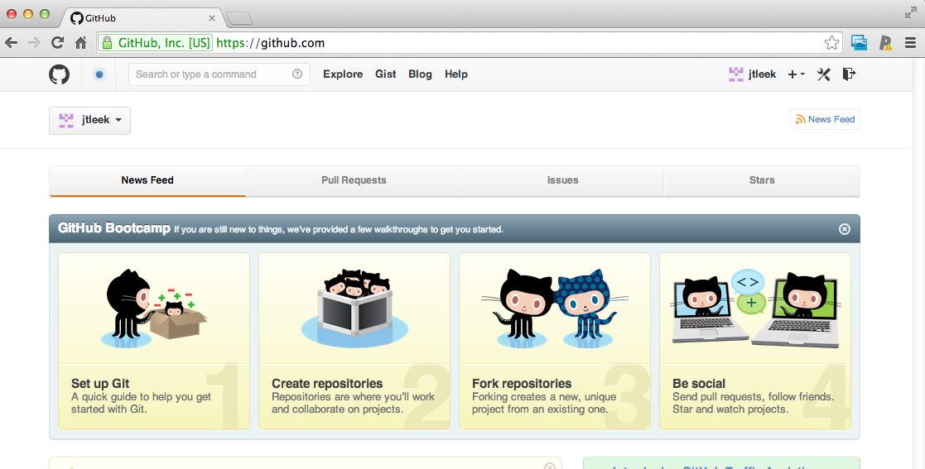
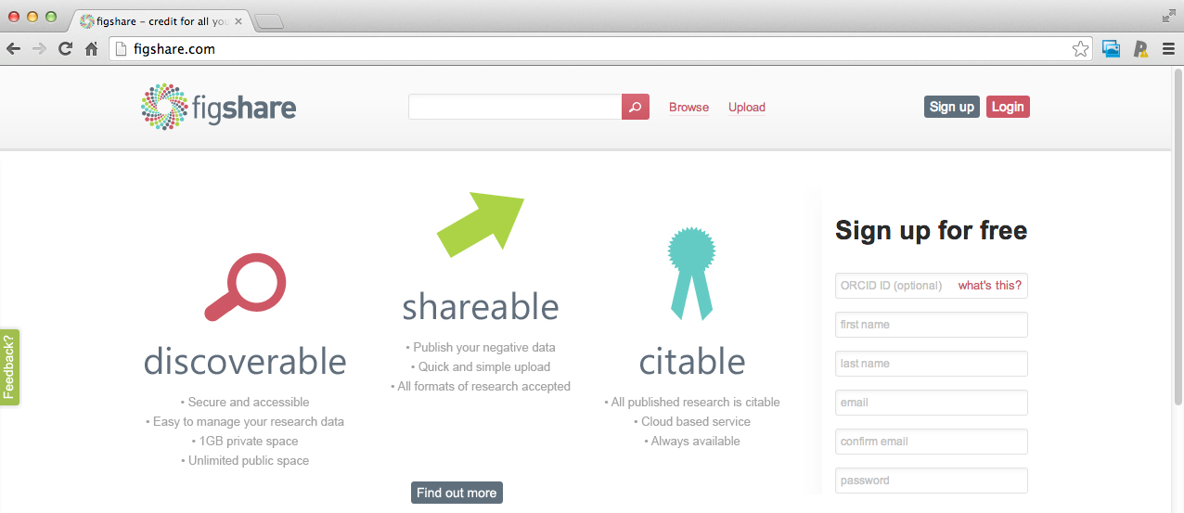
Have a plan for data and code sharing
http://figshare.com/
https://github.com/

Slide 53
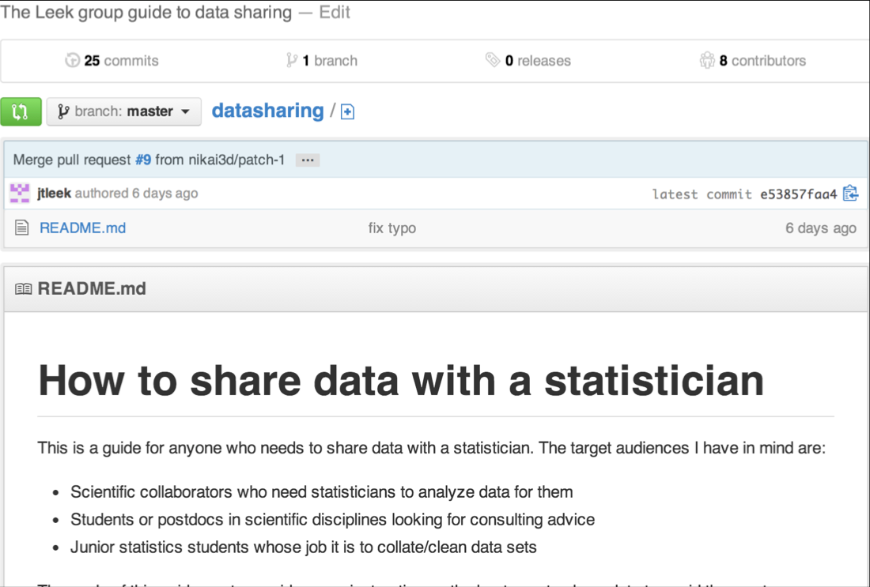
May I recommend?
https://github.com/jtleek/datasharing

Slide 54

Formulate your question in advance
Question: Does changing the text on your website improve donations?
Experiment:
Randomly show visitors one version or the other
Measure how much they donate
Determine which is better
http://www.wired.com/business/2012/04/ff_abtesting

Slide 55
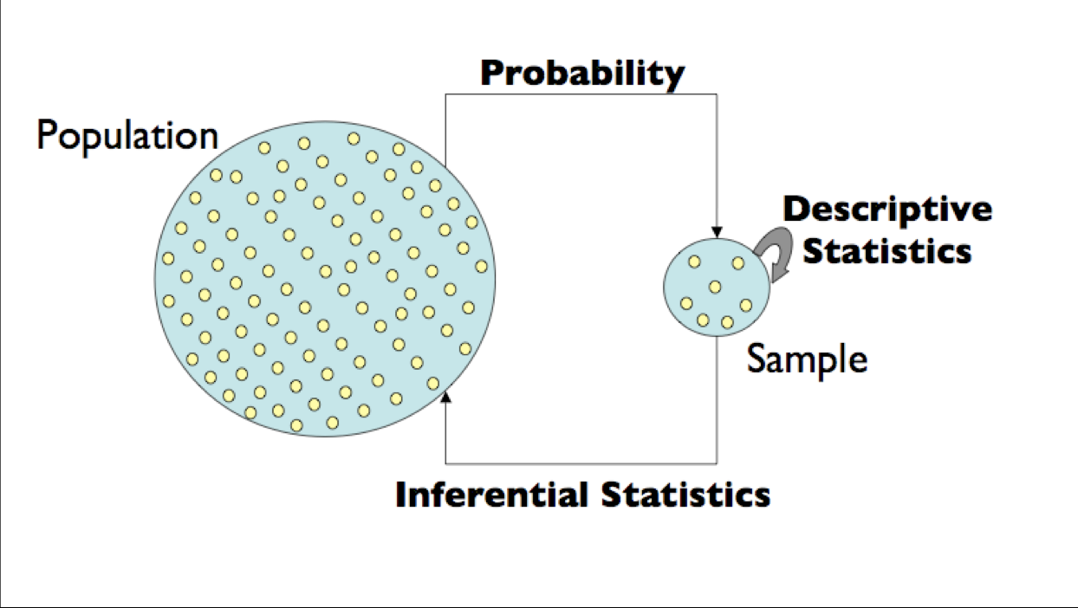
Statistical inference (статистичні виводи)
Ймовірність
Набір даних
Описова статистика
Вибірка
Дедуктивна статистика
http://www.gs.washington.edu/academics/courses/akey/56008/lecture/lecture2.pdf

Slide 56
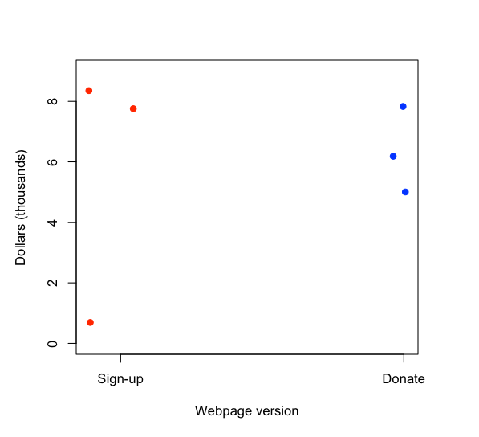
Variability (варіативність) - Scenario 1

Slide 57
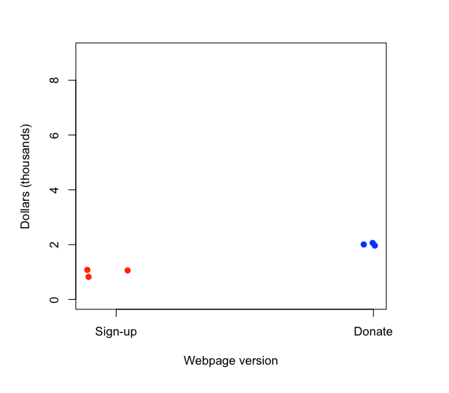
Variability (варіативність) - Scenario 2

Slide 58
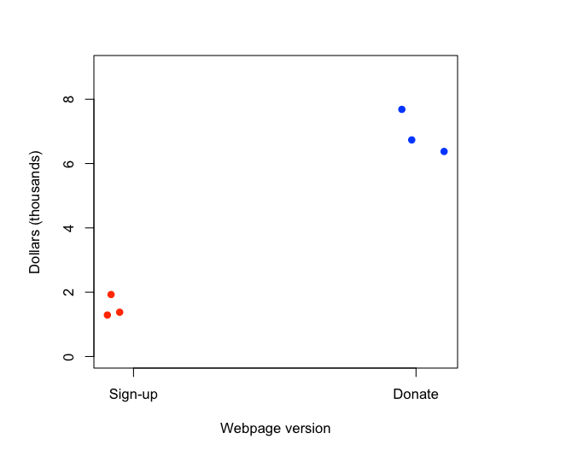
Variability (варіативність) - Scenario 3

Slide 59
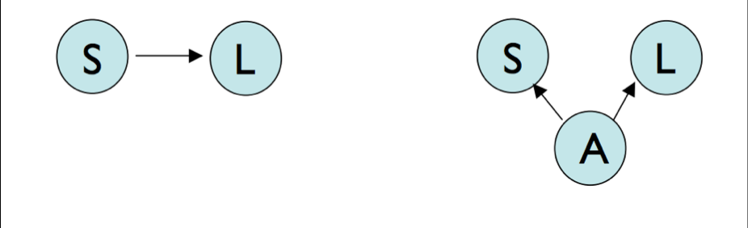
Confounding (спотворювання)
Size
Literacy
Age

Slide 60
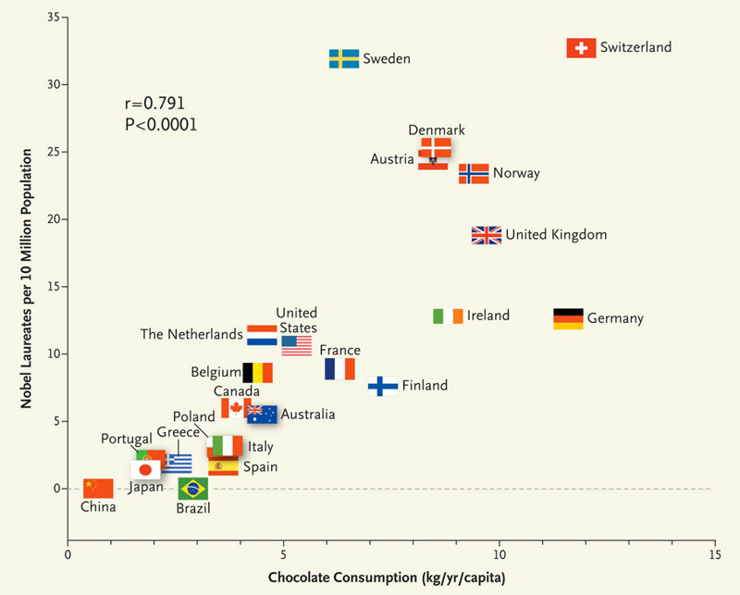
Correlation is not causation*
http://www.nejm.org/doi/full/10.1056/NEJMon1211064
Sometimes called spurious correlation (хибна кореляція)*

Slide 61
Randomization and blocking
If you can (and want to) fix a variable
Website always says Obama 2012 on it
If you don't fix a variable, stratify it (стратифікуйте її)
If you are testing sign up phrases and have two website colors, use both phrases equally on both.
If you can't fix a variable, randomize it

Slide 62
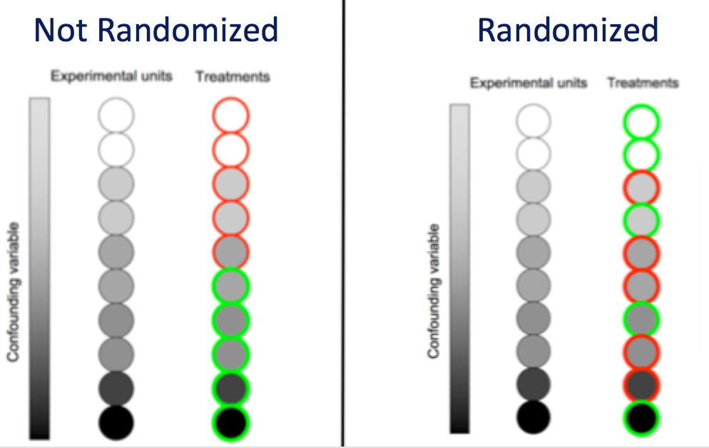
Why does randomization help?
спотворюючий фактор
спотворюючий фактор
http://www.gs.washington.edu/academics/courses/akey/56008/lecture/lecture1.pdf

Slide 63
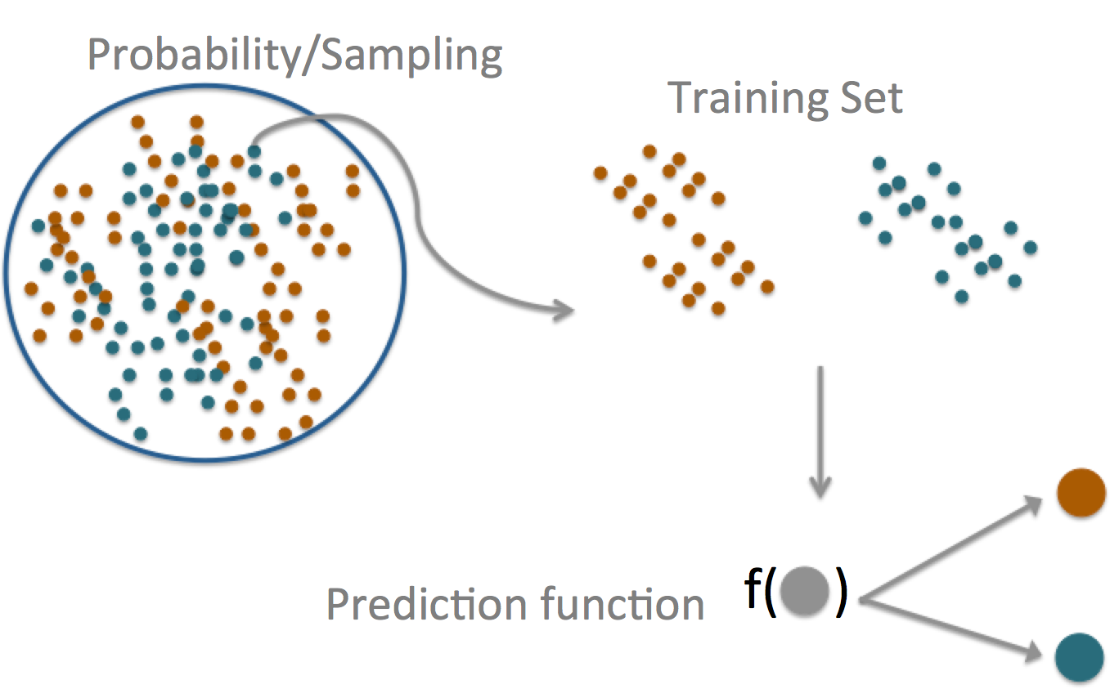
Prediction

Slide 64
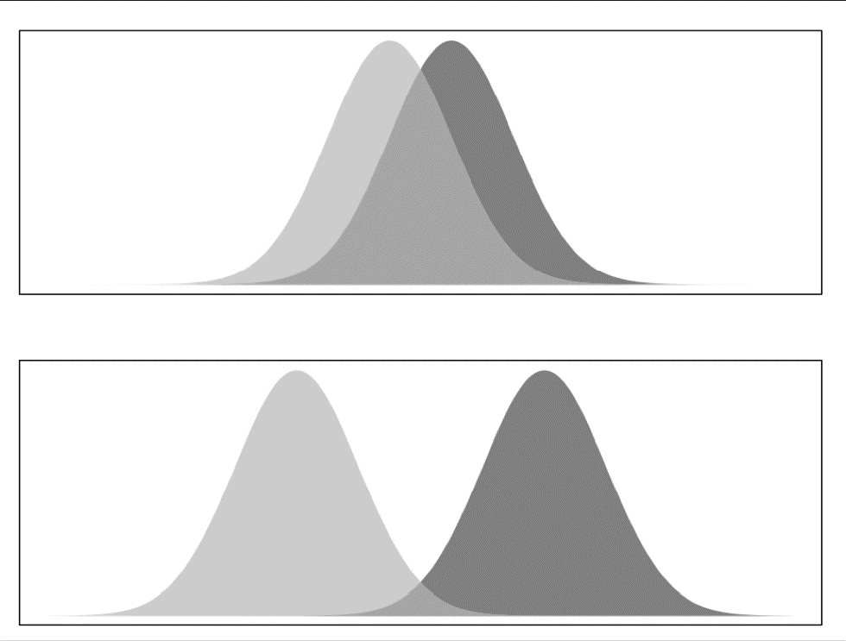
Prediction versus inference
http://www.biostat.jhsph.edu/%7Eiruczins/teaching/140.615/

Slide 65
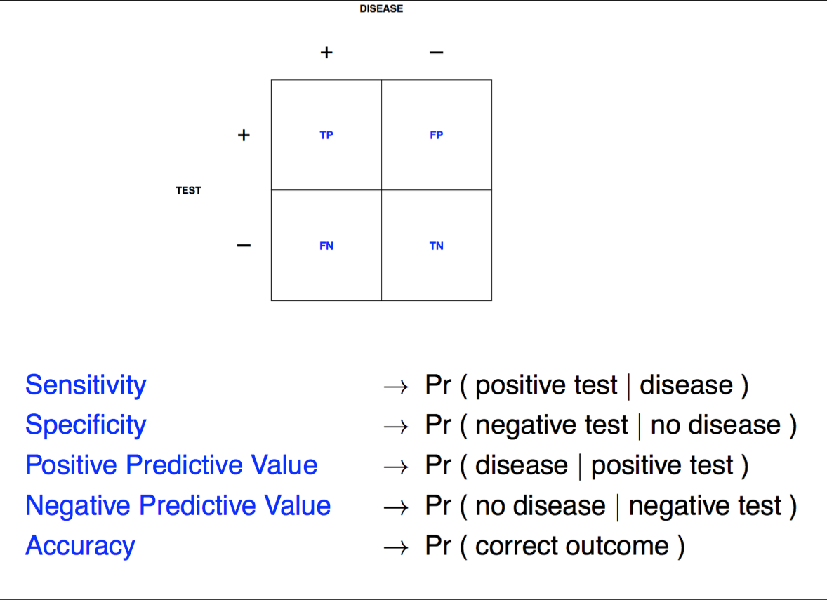
Prediction key quantities (ключові параметри)
TP – істинно позитивний
FP – хибно позитивний
FN – хибно негативний
TN – істинно негативний
чутливість
специфічність
поз. прогностичність
нег. прогностичність
точність
http://www.biostat.jhsph.edu/%7Eiruczins/teaching/140.615/

Slide 66
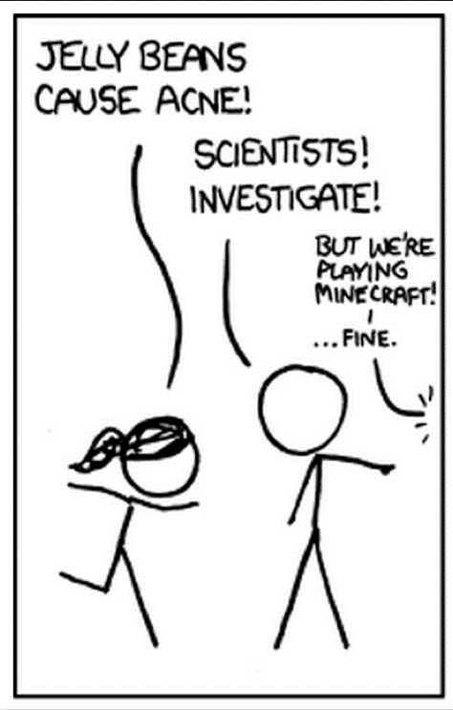
Beware data dredging
Бережіться апостеріорного аналізу (або сліпого прочісування даних)
http://xkcd.com/882/

Slide 67
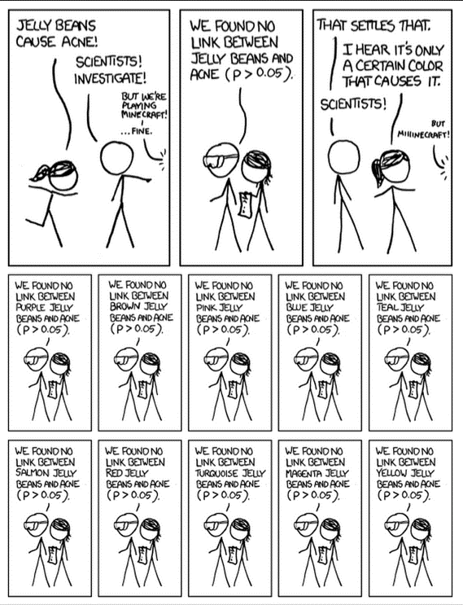
Beware data dredging
Бережіться апостеріорного аналізу (або сліпого прочісування даних)
http://xkcd.com/882/

Slide 68
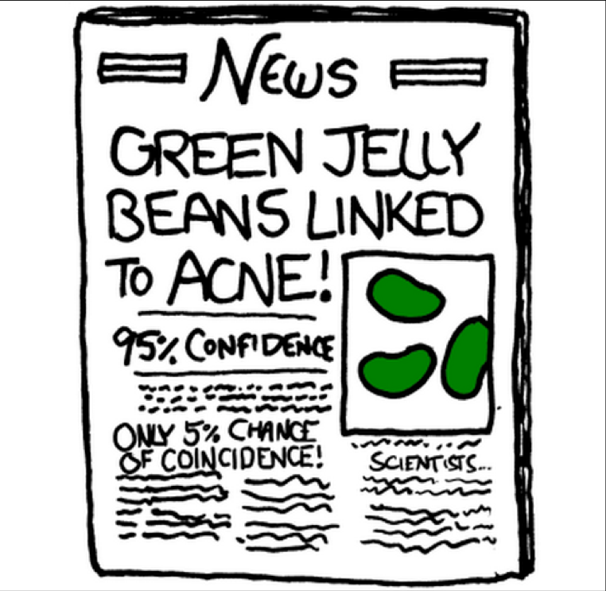
Beware data dredging
Бережіться апостеріорного аналізу (або сліпого прочісування даних)
95% довіри
тільки 5% співпадання
http://xkcd.com/882/

Slide 69
Summary
Good experiments
Have replication (можна повторювати)
Measure variability (розкид вимірювань, що дозволяє оцінити шуканий сигнал)
Generalize to the problem you care about (узагальнюють проблему, що розглядається)
Are transparent (прозорі в плані регламенту і даних)
Prediction is not inference (прогнозування і статистичні висновки не одне і теж саме)
Both can be important
Beware data dredging (Бережіться проблеми апостеріорного аналізу)

Slide 70
References
Course materials for the Data Science Specialization: https://www.coursera.org/specialization/jhudatascience/1 https://github.com/DataScienceSpecialization/courses
The Elements of Data Analytic Style. A guide for people who want to analyze data. Jeff Leek. This book is for sale at http://leanpub.com/datastyle
https://datascientistinsights.com/2013/01/29/six-types-of-analyses-every-data-scientist-should-know/

